Slide 1
Alma Parent Training
September 2022
Presented by Jennifer Heulings
Notes:
Welcome everyone
New school year
New system

Slide 2
Welcome!
What is get Alma?
Alma is a secure, easy-to-use online system that brings important school information and tools together in one place. We expect this to bring staff, students, and parents together and make it easier to get a complete view of what's happening with each student's learning.

Slide 3
Agenda
Topic 1 -Logging in
-Dashboard
-Profile
-Settings
Topic 2 – Calendar
Topic 3 – Student Section
Topic 4 – Messaging
Notes:
Tonight I will be showing you how to navigate through the new system.

Slide 4
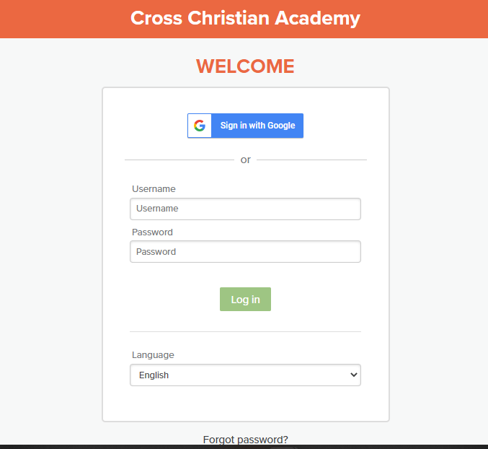
Logging in
Search: crosschristian.getalma.com
Username: first.last
Password: must be set up through an email that will be sent to you.
Notes:
Search website
Unername is first.lastname
Password must be set up through your email

Slide 5
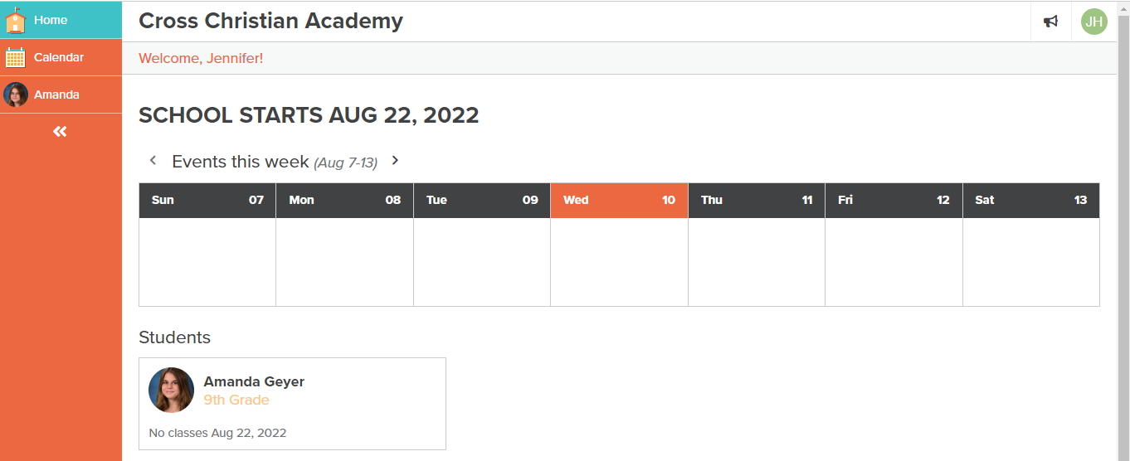
Dashboard
The dashboard will have a calendar showing fundraisers, events, assignments, and other important information.
You will see your child(ren) with a list of classes below.
On the right you will see a side menu bar.

Slide 6
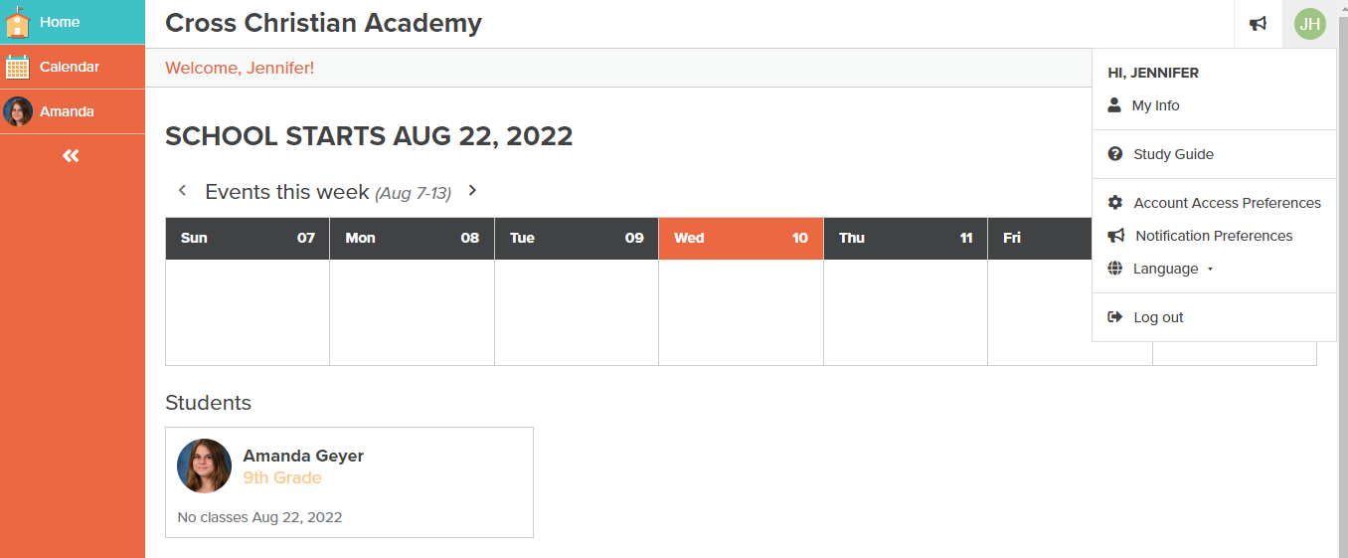
If you click your initials in the top right corner a drop down menu will appear.

Slide 7
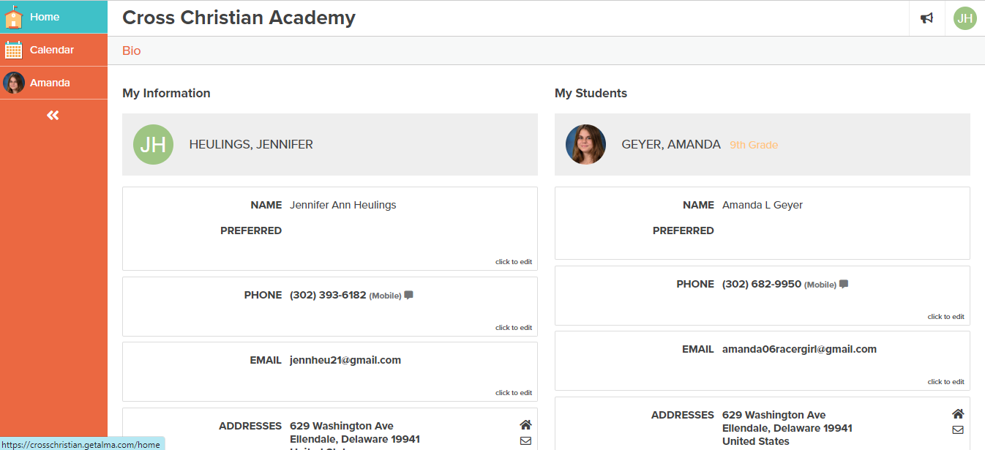
Profile
Here you will find your information. This makes address or phone number changes a breeze!

Slide 8
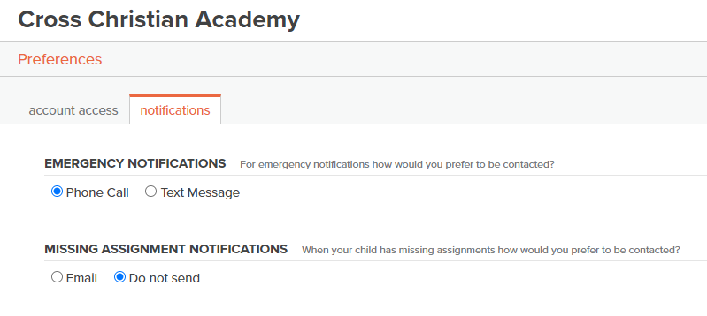
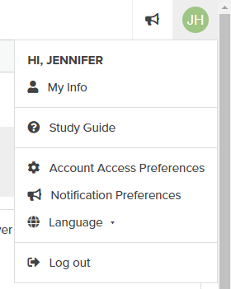
Settings

Slide 9
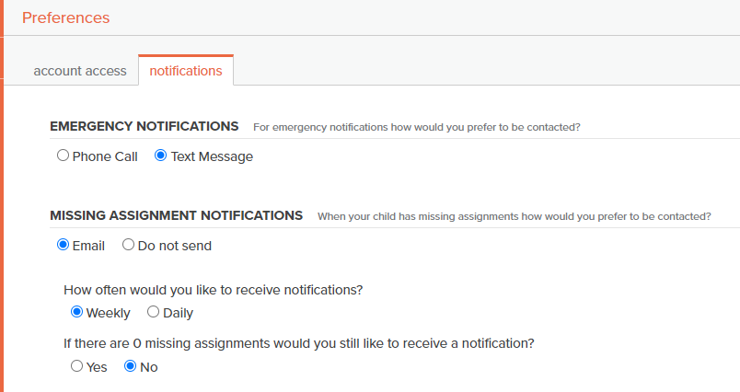
You can select whether you receive a phone call or a text notification. The call or text will come from a 503 number. Also, how you would like to know about missing assignments. After you have made your changes don’t forget to click save!

Slide 10
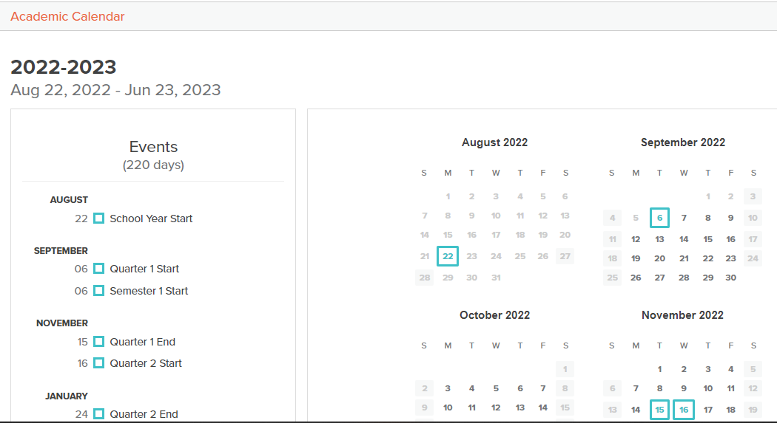
Calendar
Notes:
This is a larger look at upcoming events in a more familiar way

Slide 11
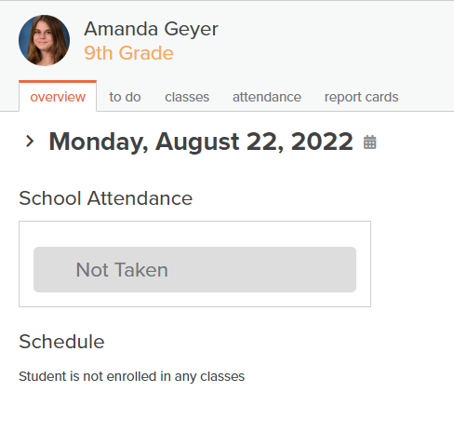
Student Section

Slide 12
Messaging

Slide 13
Mobile App

Slide 14
Thank You!

